Slide 1
3D Variability Analysis in cryo-EM
Szu-Chi Chung
Institute of Statistical Science, Academia Sinica

Slide 2
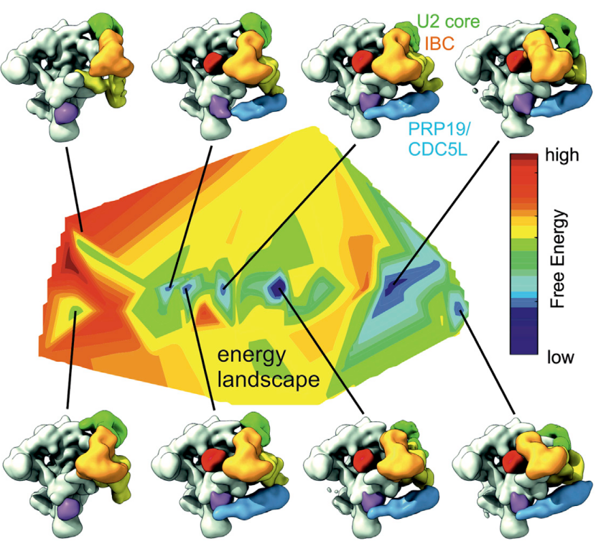
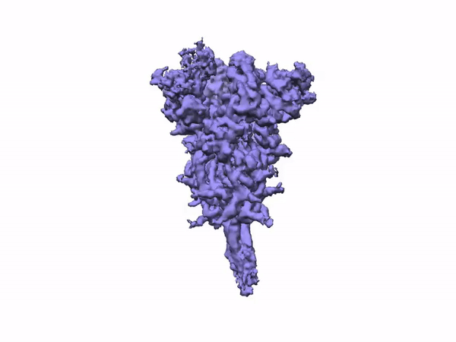
3D Variability
https://www.cell.com/cell/pdf/S0092-8674(18)30047-3.pdf
https://cryosparc.com/blog/2019-ncov
Notes:
https://cryosparc.com/blog/2019-ncov
3D Variability Analysis in cryoSPARC v2 resolves flexible conformational change of the S-protein

Slide 3
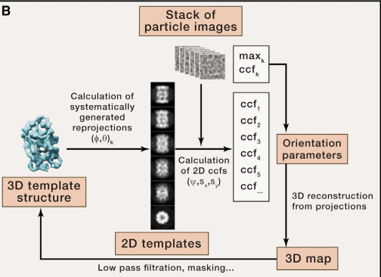

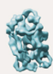
Multi-reference Classification/ Maximum Likelihood Classification [1]
Multiple initial 3D models will be generated through perturbation of the consensus 3D models
Hard to deal with
Unknown number of discrete state
Continuous conformations
Notes:
Find the set of parameters that most likely determine the observed data
Discrete parameter assignment are replaced by probability-weighted integrations over all possible assignments
Each image is assigned by all orientations and classes with weights

Slide 4
Taxonomy of computational method [2]

Slide 5
Classification Based on Statistical Analysis [2]
Estimate 3D Covariance matrix
From 2D covariance matrix [16]
From heavily downsample 2D images [13,14]
3D variance map can be use for focus classification [8,9]
Don’t need to construct 3D covariance matrix
Eigenvectors can also be estimated
Using large series of 3D reconstructions
Obtained by random bootstrapping 2D images [3,15]
Direct from 2D images [4,5,6,7,12]
Focus classification
Notes:
Global 3D voxel-by-voxel varianc
Subset obtained by 2D variance images calculated from particles assigned to the same direction

Slide 6
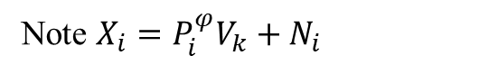
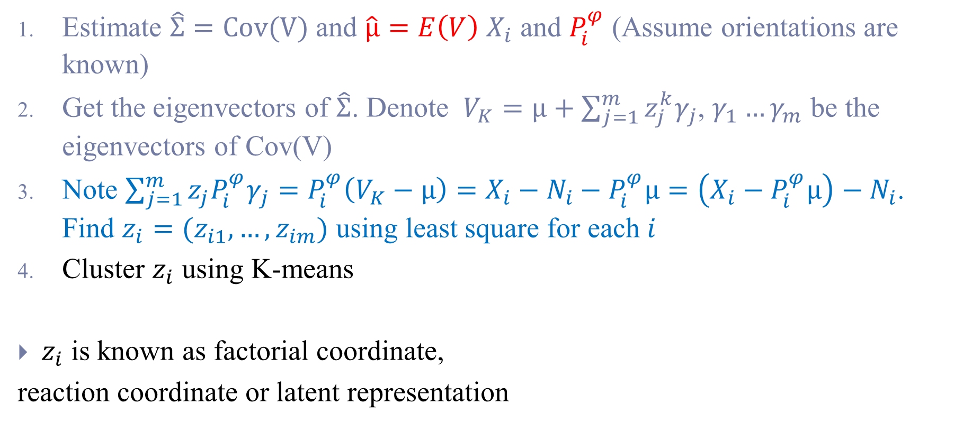
Heterogeneity Problem
Note $X_{i}=P_{i}^{φ}V_{k}+N_{i}$
Estimate $\hat{Σ}=Cov(V)$and $\hat{μ}=E\left(V\right)$ $X_{i}$ and $P_{i}^{φ}$ (Assume orientations are known)
Get the eigenvectors of $\hat{Σ}$. Denote $V_{K}=μ+\sum_{j=1}^{m}{{z_{j}^{k}γ}_{j}}$, $γ_{1}…γ_{m}$ be the eigenvectors of Cov(V)
Note $\sum_{j=1}^{m}{{{z_{j}P}_{i}^{φ}γ}_{j}}=P_{i}^{φ}\left(V_{K}−μ\right)=X_{i}−N_{i}−P_{i}^{φ}μ=\left(X_{i}−P_{i}^{φ}μ\right)−N_{i}$. Find $z_{i}=(z_{i1},…,z_{im})$ using least square for each $i$
Cluster $z_{i}$ using K-means
$z_{i}$ is known as factorial coordinate,
reaction coordinate or latent representation

Slide 7
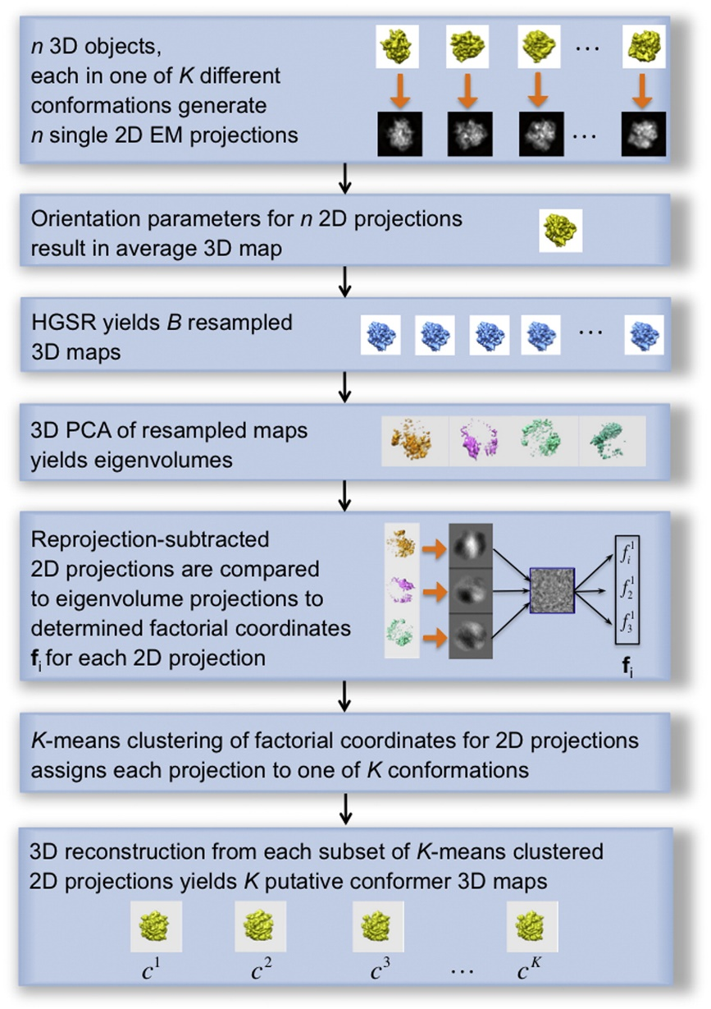
1. Eigen-Analysis [3]
HyperGeometric Stratified Resampling (HGSR) scheme
Bootstrap may results in non-uniform distribution
The resampled volumes may contains streak patterns
Using factorial coordinate for clustering
<10
Notes:
HGRS resampling is stratified
https://github.com/cryoem/eman2/blob/master/sparx/libpy/applications.py#L17466

Slide 8
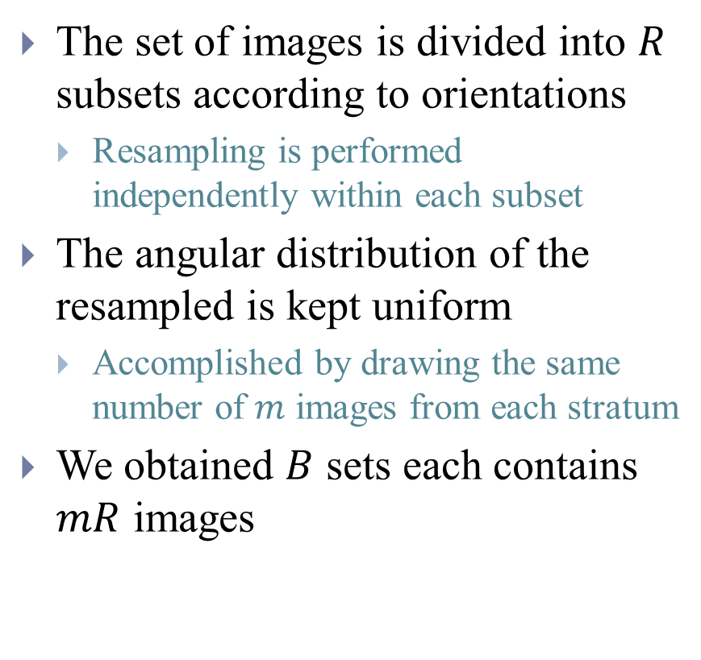
1. Eigen-Analysis [3] - HGSR
The set of images is divided into $R$ subsets according to orientations
Resampling is performed independently within each subset
The angular distribution of the resampled is kept uniform
Accomplished by drawing the same number of $m$ images from each stratum
We obtained $B$ sets each contains $mR$ images

Slide 9
1. Eigen-Analysis - Synthetic data
70S Ribosome Synthetic

Slide 10
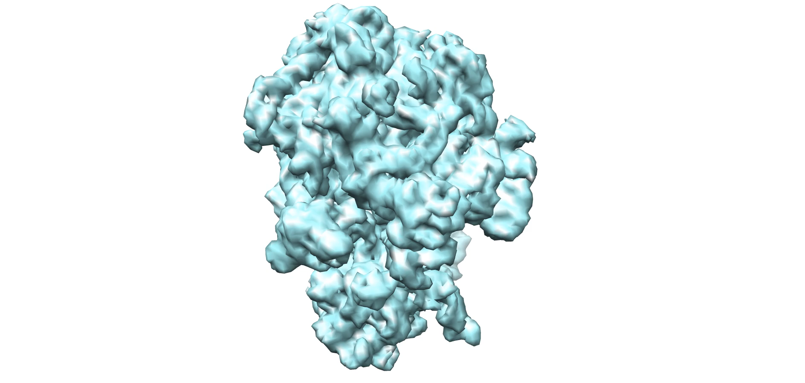
1. Eigen-Analysis - Conformation
P-site tRNA
50S
E-site tRNA
EF-G
30S

Slide 11
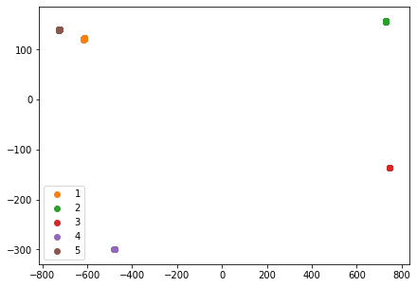
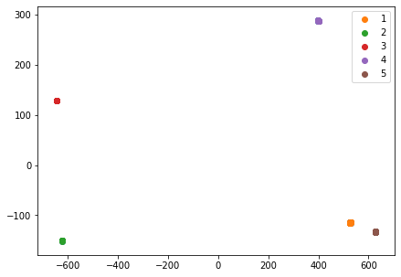
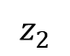
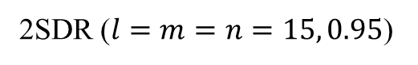
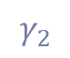
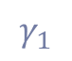
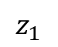
1. Eigen-Analysis - PCA vs 2SDR
Direct on 100 structures
PCA
2SDR ($l=m=n=15, 0.95$)
$$γ_{1}$$
$$γ_{2}$$
$$z_{2}$$
$$z_{1}$$

Slide 12
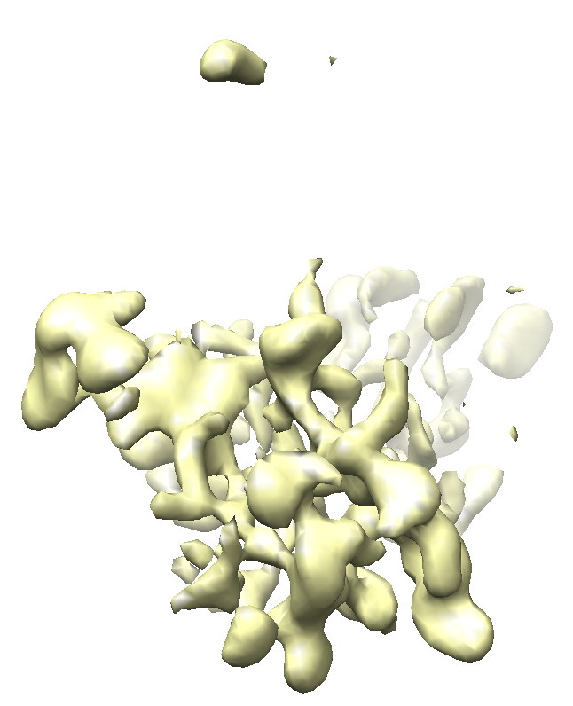
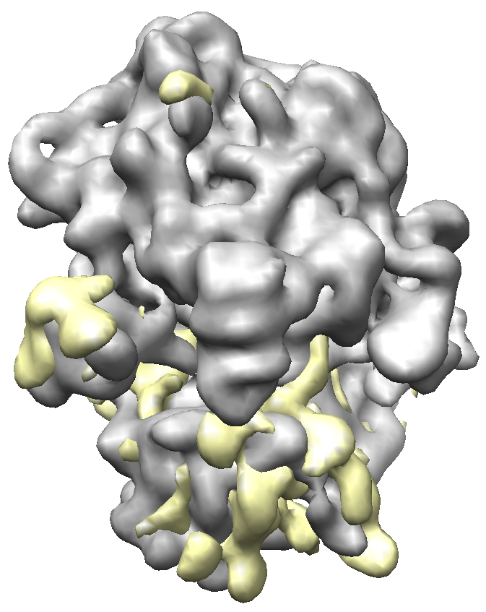
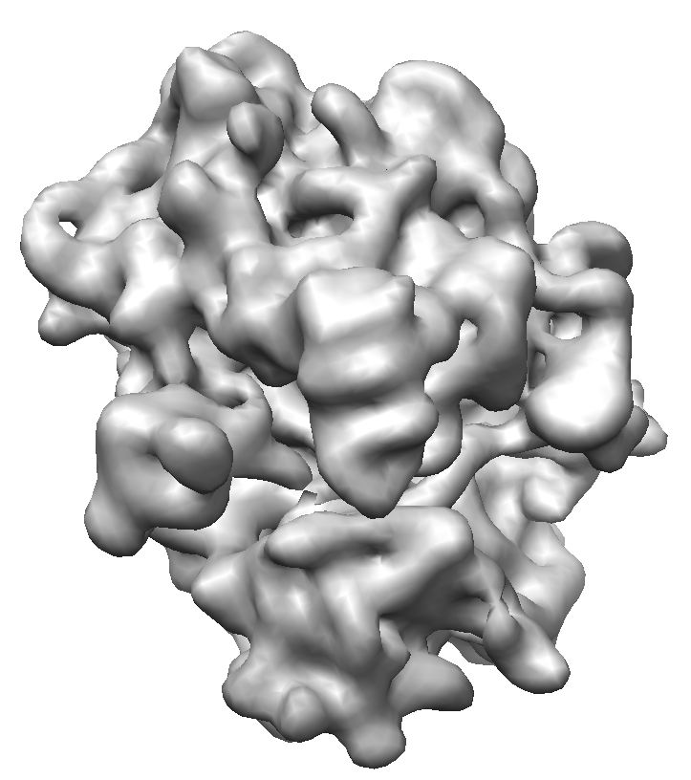
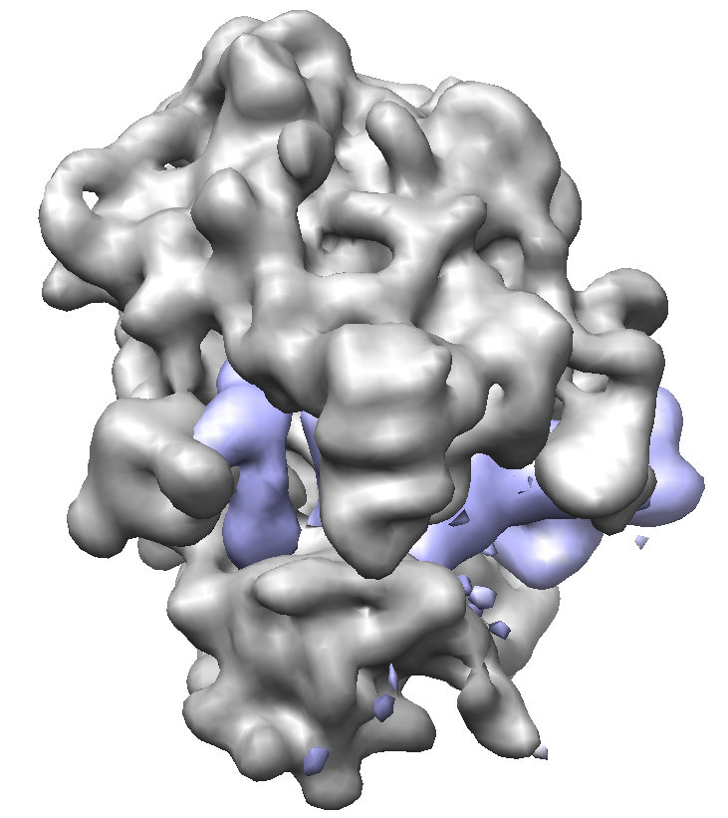
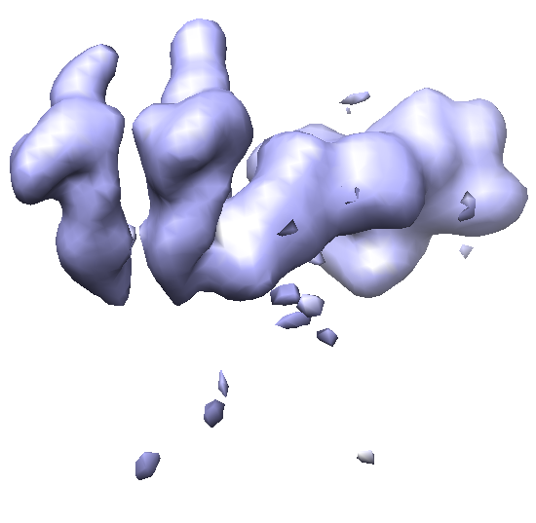
1. Eigen-Analysis - Interpretation of eigenvolume
Eigenvolume 1
+
=
Eigenvolume 2

Slide 13
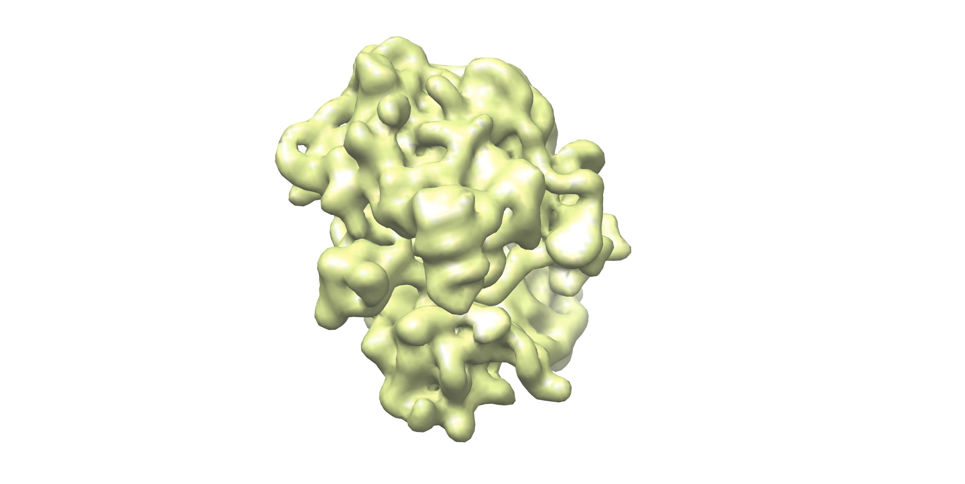
1. Eigen-Analysis - 3DPCA – (Continuous)
First Eigenvolume represents Rotation between 30s and 50s subunit
Average+eigenvolume*p
Structure2*(1-p)+Struture4*p
Notes:
https://www.cgl.ucsf.edu/chimera/docs/ContributedSoftware/morphmap/morphmap.html

Slide 14
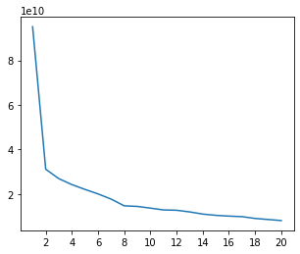
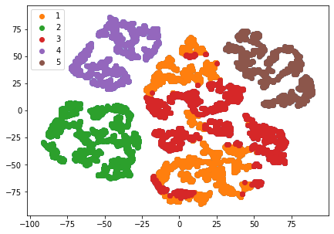
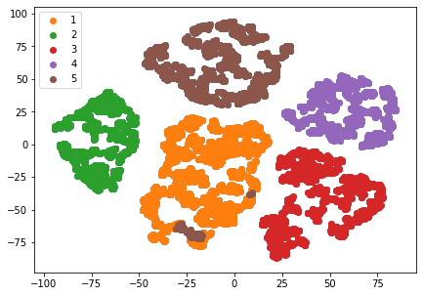
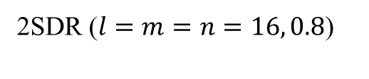
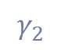
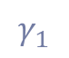
1. Eigen-Analysis - PCA vs 2SDR
SNR (direct/resample) | impurity | C-impurity
PCA | 0/0.1995 | 0/0.2413
2SDR | 0/0.0106 | 0/0.0106
11000 resampled volumes from clean data
PCA
2SDR ($l=m=n=16, 0.8$)
eigenvalue
$$γ_{1}$$
$$γ_{2}$$
eigenvector

Slide 15
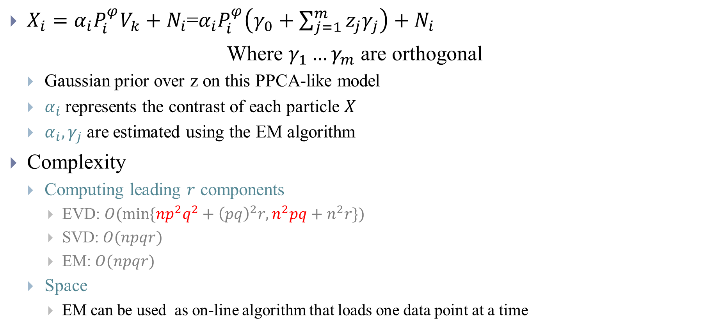
2. 3DVA [4,5]
$X_{i}={α_{i}P}_{i}^{φ}V_{k}+N_{i}$=${α_{i}P}_{i}^{φ}\left(γ_{0}+\sum_{j=1}^{m}{{z_{j}γ}_{j}}\right)+N_{i}$
Where $γ_{1}…γ_{m}$ are orthogonal
Gaussian prior over z on this PPCA-like model
$α_{i}$represents the contrast of each particle $X$
$α_{i},γ_{j}$are estimated using the EM algorithm
Complexity
Computing leading $r$ components
EVD: $O(min⁡\{{np}^{2}q^{2}+{\left(pq\right)}^{2}r,n^{2}pq+n^{2}r\})$
SVD:$O(npqr)$
EM: $O(npqr)$
Space
EM can be used as on-line algorithm that loads one data point at a time
E-step
M-step
Bishop, Christopher M. Pattern recognition and machine learning. springer, 2006.
Notes:
E-step:
$$z_{i}^{∗}=arg\min_{z_{i}}=\frac{1}{2}{\left\|X_{i}−{αP}_{i}^{φ}(γ_{0}+\sum_{j=1}^{m}{{z_{ij}γ}_{j}})\right\|}_{}^{2}$$
M-step
$$γ_{k}^{∗}=arg\min_{γ_{i}}=\frac{1}{2}\sum_{i}{{\left\|X_{i}−{αP}_{i}^{φ}(γ_{0}+\sum_{j=1}^{m}{{z_{ij}γ}_{j}})\right\|}_{}^{2}}$$

Slide 16
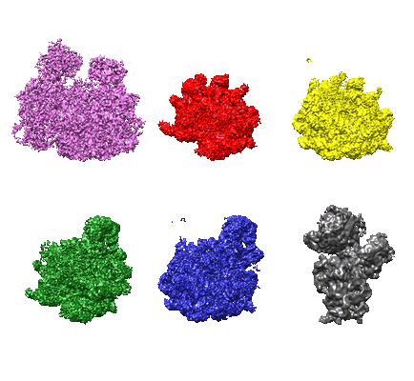
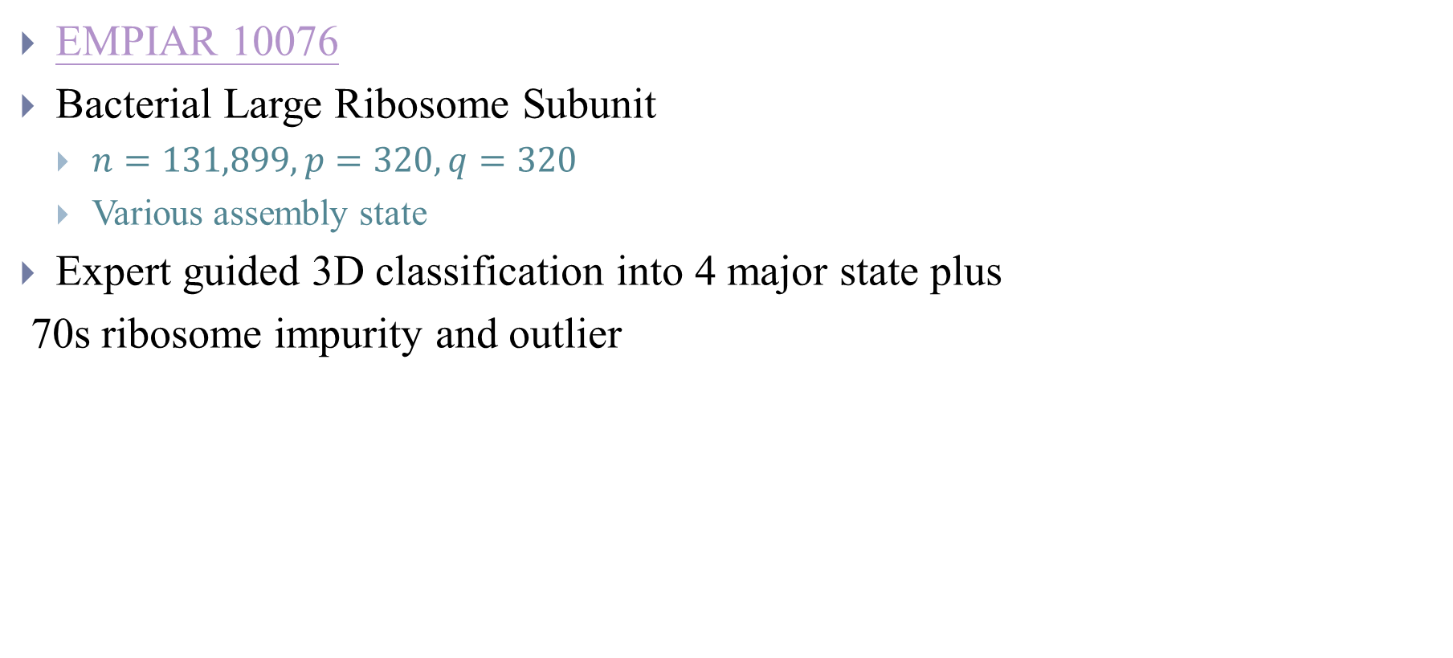
50S Ribosomal Intermediates Experiment Dataset
EMPIAR 10076
Bacterial Large Ribosome Subunit
$n=131,899, p=320, q=320$
Various assembly state
Expert guided 3D classification into 4 major state plus
70s ribosome impurity and outlier

Slide 17
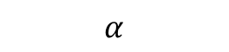
2. 3DVA (Discrete analysis)
Cluster mode
$$α$$
Can detect outlier

Slide 18
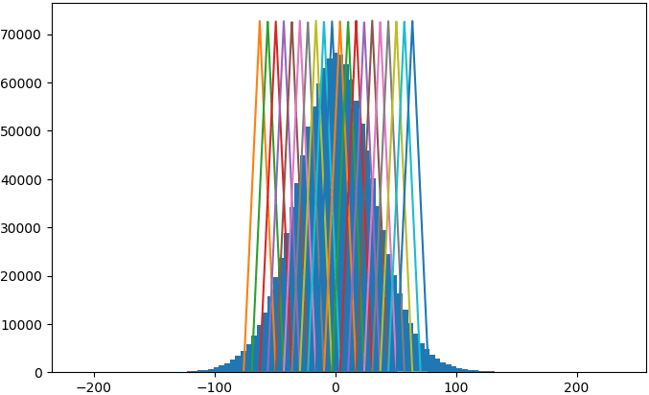
2. 3DVA (Continuous analysis)
Simple mode (Consensus structure plus fraction of eigenvolume)
Intermediate mode (Separate weighted (kernel) reconstruction along reaction coordinate)
Detect small variation
Notes:
https://www.notion.so/3D-Variability-Analysis-3DVA-5f351d70f18042e6b32c215372639335

Slide 19
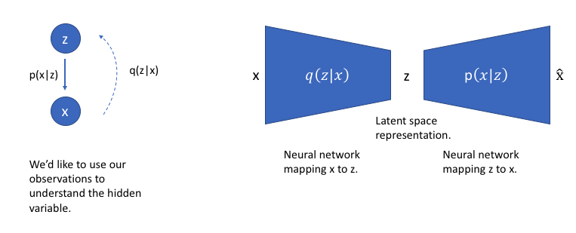
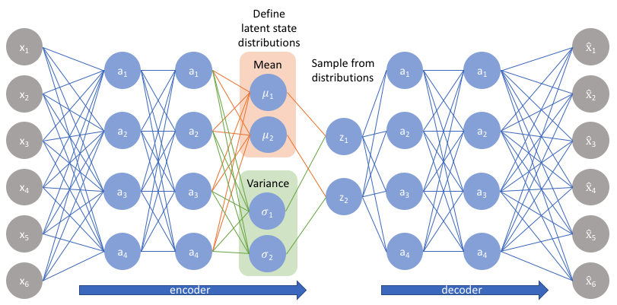
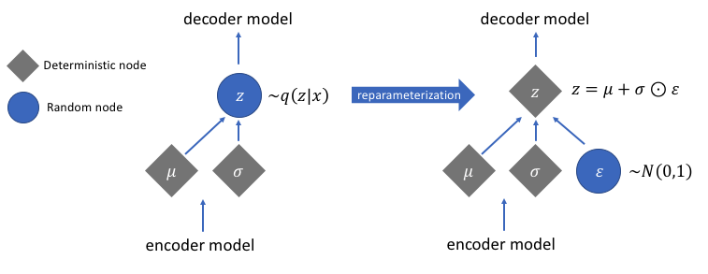
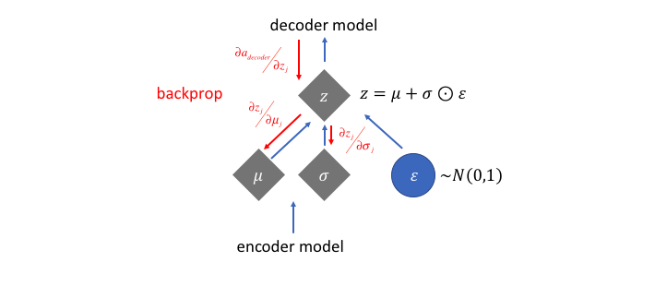
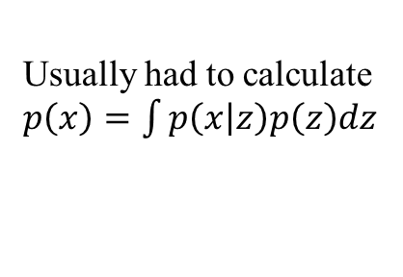
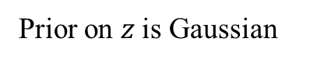
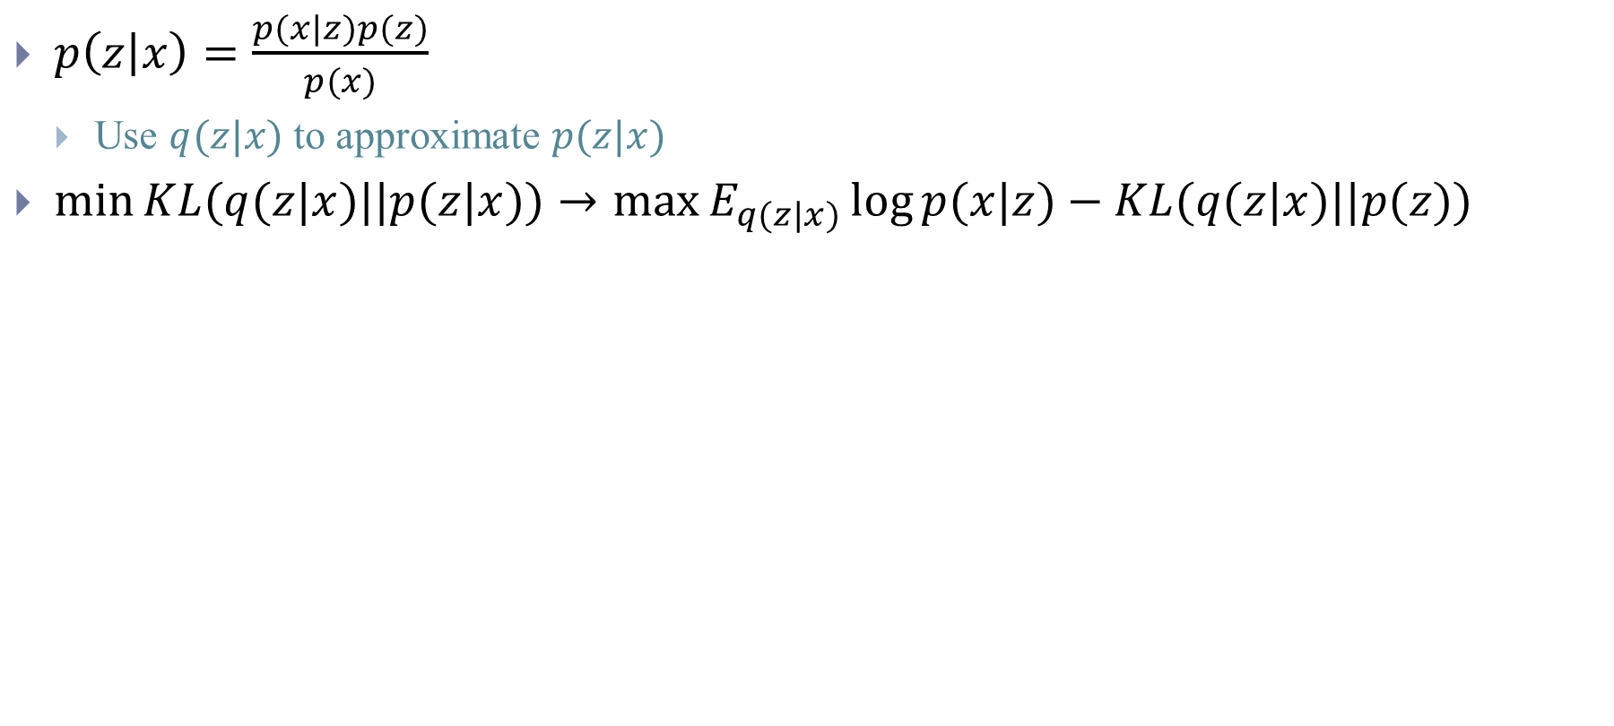
Variational autoencoder
$p\left(z | x\right)=\frac{p(x|z)p(z)}{p(x)}$
Use $q(z|x)$ to approximate $p(z|x)$
$\min{KL(q(z|x)||p(z|x))}→\max{E_{q(z|x)}\log{p(x|z)}−KL(q(z|x)||p(z))}$
Usually had to calculate $p\left(x\right)=\int{p\left(x | z\right)p\left(z\right)dz}$
Prior on $z$is Gaussian
Notes:
In order to deal with the fact that the network may learn negative values for σσ, we'll typically have the network learn logσlog⁡σ and exponentiate this value to get the latent distribution's variance.
It asks how likely we are to start at an image x, encode it to z, decode it, and get back the original x.

Slide 20
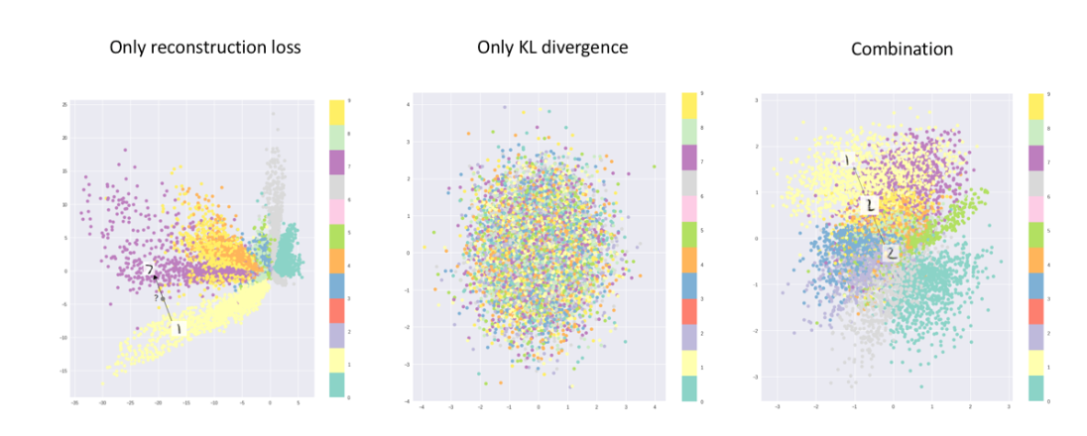
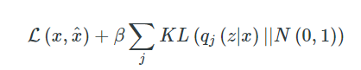
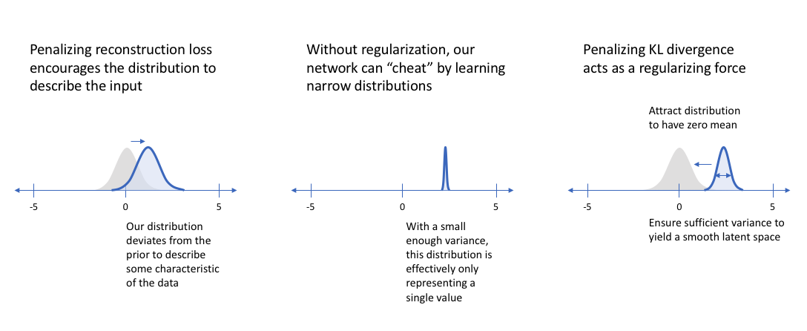
Variational autoencoder (https://www.jeremyjordan.me/variational-autoencoders/)
The latent space
Notes:
https://www.jeremyjordan.me/variational-autoencoders/
The model is now exposed to a certain degree of local variation by varying the encoding of one sample, resulting in smooth latent spaces on a local scale, that is, for similar samples. Ideally, we want overlap between samples that are not very similar too, in order to interpolate between classes. However, since there are no limits on what values vectors μ and σ can take on, the encoder can learn to generate very different μ for different classes, clustering them apart, and minimize σ, making sure the encodings themselves don’t vary much for the same sample

Slide 21
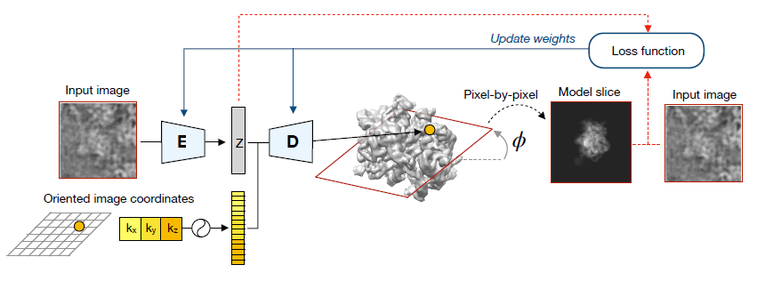
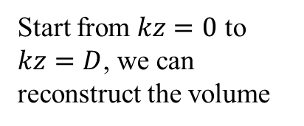
3. CryoDRGN [6,7]
Start from $kz=0$ to $kz=D$, we can reconstruct the volume
Expand coordinate to Fourier basis
Apply CTF and translation
Apply rotation

Slide 22
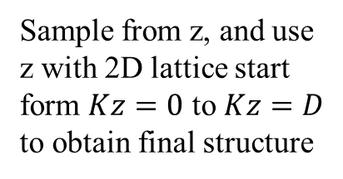
3. CryoDRGN [6,7]
Sample from z, and use z with 2D lattice start form $Kz=0$ to $Kz=D$ to obtain final structure

Slide 23
3. CryoDRGN - Architecture vs Training Time

Slide 24
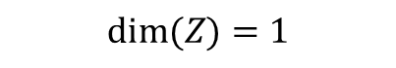
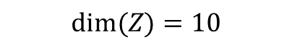
3. CryoDRGN – Discrete analysis
$$dim⁡(Z)=1$$
$$dim⁡(Z)=10$$
Can detect outlier

Slide 25
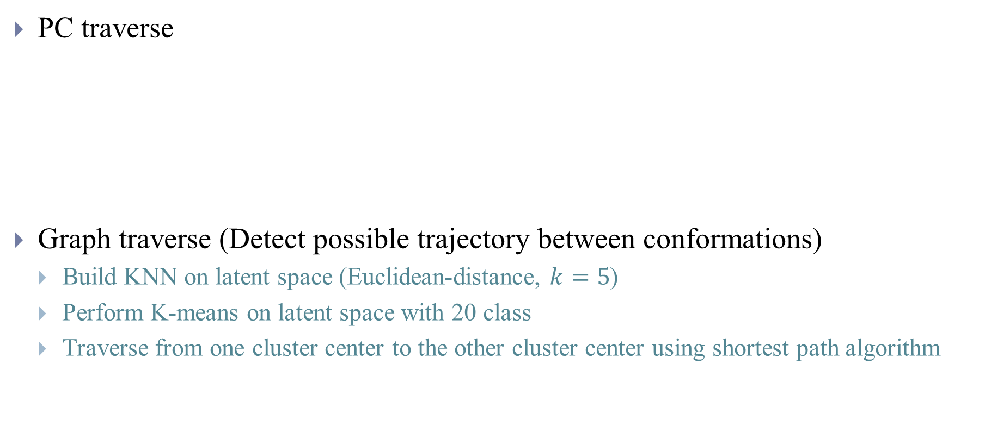
3. CryoDRGN – Continuous analysis
PC traverse
Graph traverse (Detect possible trajectory between conformations)
Build KNN on latent space (Euclidean-distance, $k=5$)
Perform K-means on latent space with 20 class
Traverse from one cluster center to the other cluster center using shortest path algorithm

Slide 26

4. Experiment data - 70s Ribosome
70s Ribosome ($p =130, q =130, n=10000$)
The first 5000 particles contains EF-G

Slide 27









4. Experiment data - 70s Ribosome
11000 resample volumes with $75×75×75$ voxels
PCA
2SDR($l=m=n=19, 0.9$)
impurity
eigenvalue
eigenvector
eigenvector

Slide 28

4. Experiment data - 70s Ribosome
3DVA: $130×130×1$30 voxels
CryoDRGN: $128×128×128$ voxels
 | impurity
Resample +PCA | 0.1478 | 33 min (~1 min)
Resample +2SDR | 0.1076 | 35 min (~3 min)
3DVA | 0.1459 | 31min
CryoDRGN | 0.1072 | 73min

Slide 29


4. Possible problem with resample
Prefer orientation still affect the SNR of reconstruction
Does not deal with translation
Mask or low/high pass filter or symmetry may also need to be considered

Slide 30

Other Topics
Continuous conformation
Meaningful latent space and energy landscape
Performance evaluation
Generate synthetic data [17]
2D analysis
Real dataset
Synthetic dataset larger than 2 class

Slide 31
References
[1] Scheres, Sjors HW. "Processing of structurally heterogeneous cryo-EM data in RELION." Methods in enzymology. Vol. 579. Academic Press, 2016. 125-157.
[2] Jonić, Slavica. "Computational methods for analyzing conformational variability of macromolecular complexes from cryo-electron microscopy images." Current opinion in structural biology 43 (2017): 114-121.
[3] Penczek, Pawel A., Marek Kimmel, and Christian MT Spahn. "Identifying conformational states of macromolecules by eigen-analysis of resampled cryo-EM images." Structure 19.11 (2011): 1582-1590.
[4] Punjani, Ali, and David J. Fleet. "3D Variability Analysis: Directly resolving continuous flexibility and discrete heterogeneity from single particle cryo-EM images." bioRxiv (2020).
[5] CryoSparc 3DVA : https://cryosparc.com/docs/tutorials/3d-variability-analysis
[6] Zhong, Ellen D., et al. "Reconstructing continuously heterogeneous structures from single particle cryo-EM with deep generative models." arXiv preprint arXiv:1909.05215 (2019).
[7] Zhong, Ellen D., et al. "CryoDRGN: Reconstruction of heterogeneous structures from cryo-electron micrographs using neural networks." bioRxiv (2020).
[8] Nakane, Takanori, et al. "Characterisation of molecular motions in cryo-EM single-particle data by multi-body refinement in RELION." Elife 7 (2018): e36861.
[9] Ilca, Serban L., et al. "Localized reconstruction of subunits from electron cryomicroscopy images of macromolecular complexes." Nature Communications 6 (2015): 8843.

Slide 32
References
[10] Frank, Joachim, and Abbas Ourmazd. "Continuous changes in structure mapped by manifold embedding of single-particle data in cryo-EM." Methods 100 (2016): 61-67.
[11] Jin, Qiyu, et al. "HEMNMA: hybrid electron microscopy normal mode analysis to fully explore macromolecular dynamics." Structure 22 (2014): 496-506.
[12] Tagare, Hemant D., et al. "Directly reconstructing principal components of heterogeneous particles from cryo-EM images." Journal of structural biology 191.2 (2015): 245-262.
[13] Katsevich, Eugene, Alexander Katsevich, and Amit Singer. "Covariance matrix estimation for the cryo-EM heterogeneity problem." SIAM journal on imaging sciences 8.1 (2015): 126-185.
[14] Andén, Joakim, and Amit Singer. "Structural variability from noisy tomographic projections." SIAM journal on imaging sciences 11.2 (2018): 1441-1492.
[15] David Haselbach, Ilya Komarov, Dmitry E Agafonov, Klaus Hartmuth, Benjamin Graf, Olexandr Dy-bkov, Henning Urlaub, Berthold Kastner, Reinhard L ̈uhrmann, and Holger Stark. “Structure and con-formational dynamics of the human spliceosomal bact complex.” Cell, 172(3):454–464, 2018.
[16] Liao, Hstau Y., Yaser Hashem, and Joachim Frank. "Efficient estimation of three-dimensional covariance and its application in the analysis of heterogeneous samples in cryo-electron microscopy." Structure 23.6 (2015): 1129-1137.
[17] Seitz, Evan, et al. "Simulation of cryo-EM ensembles from atomic models of molecules exhibiting continuous conformations." BioRxiv (2019): 864116.

